Slide 1



















L8. Dynamic Bayesian Network
Dynamic Bayesian Network relates variables to each other over adjacent time steps.
$${ A_{1}}_{ }$$
$${ A_{2}}_{ }$$
$${ A_{3}}_{ }$$
$$⋯$$
$${ A_{t}}_{ }$$
$$⋯$$
$$A_{T}$$
$$X_{1}$$
$$X_{2}$$
$${ X_{3}}_{ }$$
$$⋯$$
$${ X_{t}}_{ }$$
$$⋯$$
$${ X_{T}}_{ }$$
$${ Y_{1}}_{ }$$
$${ Y_{2}}_{ }$$
$$Y_{3}$$
$$⋯$$
$${ Y_{t}}_{ }$$
$$⋯$$
$${ Y_{T}}_{ }$$

Slide 2

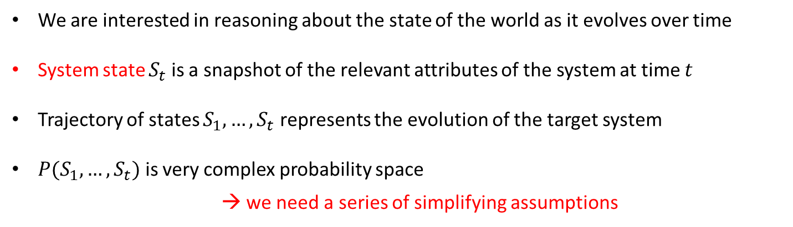






Dynamic Bayesian Networks (temporal model)
We are interested in reasoning about the state of the world as it evolves over time
System state $S_{t}$ is a snapshot of the relevant attributes of the system at time $t$
Trajectory of states $S_{1},…, S_{t}$ represents the evolution of the target system
${P(S}_{1},…,S_{t})$ is very complex probability space
→ we need a series of simplifying assumptions
$${ S_{1}}_{ }$$
$${S_{2}}_{ }$$
$$S_{3}$$
$$⋯$$
$${ S_{t}}_{ }$$
$$⋯$$
$${ S_{T}}_{ }$$

Slide 3
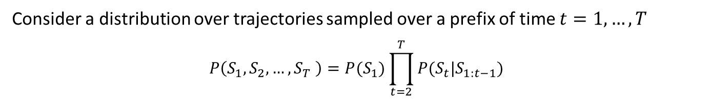
Discrete-State Markov models
Consider a distribution over trajectories sampled over a prefix of time $t=1,…,T$
$$P\left(S_{1},S_{2},…,S_{T} \right)=P(S_{1})\prod_{t=2}^{T}{P(S_{t}|S_{1:t−1})}$$
Cascade decomposition
$${ S_{1}}_{ }$$
$${S_{2}}_{ }$$
$$S_{3}$$
$$⋯$$
$${ S_{t}}_{ }$$
$$⋯$$
$${ S_{T}}_{ }$$

Slide 4






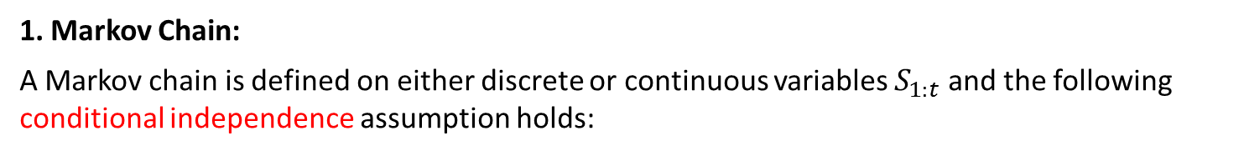

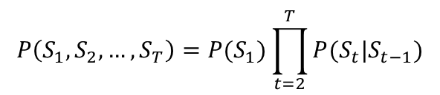


Discrete-State Markov models
Consider a distribution over trajectories sampled over a prefix of time $t=1,…,T$
$$P\left(S_{1},S_{2},…,S_{T} \right)=P(S_{1})\prod_{t=2}^{T}{P(S_{t}|S_{1:t−1})}$$
Cascade decomposition
1. Markov Chain:
A Markov chain is defined on either discrete or continuous variables $S_{1:t}$ and the following conditional independence assumption holds:
$$P\left(S_{t}|S_{1},…,S_{t−1}\right)=P\left(S_{t}|S_{t−L},…,S_{t−1}\right)$$
where $L≥$ is the order of the Markov chain. First order Markov chain can be represented
$$P\left(S_{1},S_{2},…,S_{T}\right)=P(S_{1})\prod_{t=2}^{T}{P(S_{t}|S_{t−1})}$$
$$\left(S^{t+1}⊥S^{\left(1:t−1\right)}|S^{t}\right)$$
the future is conditionally independent of the pas given the present:
$${ S_{1}}_{ }$$
$${S_{2}}_{ }$$
$$S_{3}$$
$$⋯$$
$${ S_{t}}_{ }$$
$$⋯$$
$${ S_{T}}_{ }$$
$${ S_{1}}_{ }$$
$${S_{2}}_{ }$$
$$S_{3}$$
$$⋯$$
$${ S_{t}}_{ }$$
$$⋯$$
$${ S_{T}}_{ }$$
First Order Markov Chain
Second Order Markov Chain

Slide 5
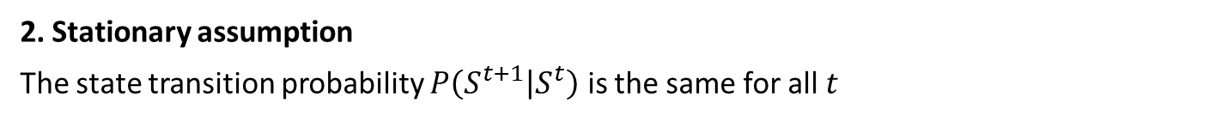
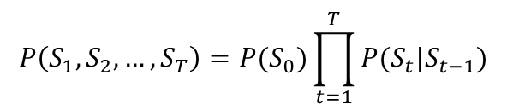
Discrete-State Markov models
Consider a distribution over trajectories sampled over a prefix of time $t=1,…,T$
$$P\left(S_{1},S_{2},…,S_{T} \right)=P(S_{1})\prod_{t=2}^{T}{P(S_{t}|S_{1:t−1})}$$
Cascade decomposition
1. Markov Chain:
A Markov chain is defined on either discrete or continuous variables $S_{1:t}$ and the following conditional independence assumption holds:
$$P\left(S_{t}|S_{1},…,S_{t−1}\right)=P\left(S_{t}|S_{t−L},…,S_{t−1}\right)$$
where $L≥$ is the order of the Markov chain. First order Markov chain can be represented
$$P\left(S_{1},S_{2},…,S_{T}\right)=P(S_{0})\prod_{t=1}^{T}{P(S_{t}|S_{t−1})}$$
2. Stationary assumption
The state transition probability $P\left(S^{t+1} | S^{t}\right)$ is the same for all $t$
$P\left(S^{t+1}=s′ | S^{t}=s\right)=P(S^{′}=s^{′}|S=s)$ for any $t$
→The number of parameters are reduced substantially

Slide 6

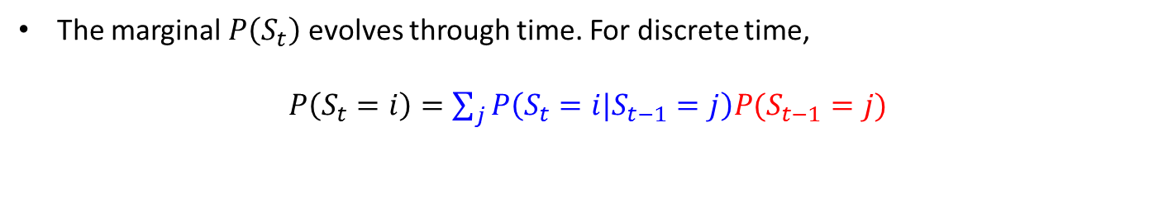


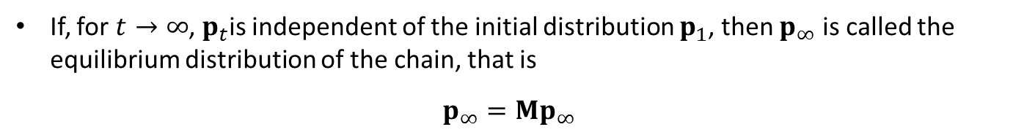

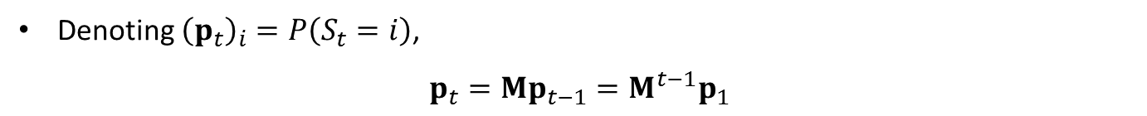


Equilibrium and stationary distribution of a Markov chain
The marginal $P\left(S_{t}\right)$ evolves through time. For discrete time,
$P\left(S_{t}=i\right)=\sum_{j}^{ }{P\left(S_{t}=i|S_{t−1}=j\right)P(S_{t−1}=j)}$
$P\left(S_{t}=i\right)$: the frequency that we visit state $i$ at time $t$, given we started with a sample
from $P\left(S_{1}\right)$ and subsequently repeatedly drew samples from the transition $P\left(S_{τ}|S_{τ−1} \right)$
$$S_{t−1}^{1}$$
$$P(S_{t−1}=j)$$
$${ S}_{t−1}^{j}$$
$$P\left(S_{t}=i|S_{t−1}=j\right)$$
$${ S}_{t}^{i}$$
$${ S}_{t−1}^{n}$$
Denoting ${\left(p_{t}\right)}_{i}=P\left(S_{t}=i\right)$,
$p_{t}=Mp_{t−1}=M^{t−1}p_{1}$
If, for $t→∞$, $p_{t}$is independent of the initial distribution $p_{1}$, then $p_{∞}$ is called the equilibrium distribution of the chain, that is
$$p_{∞}=Mp_{∞}$$

Slide 7

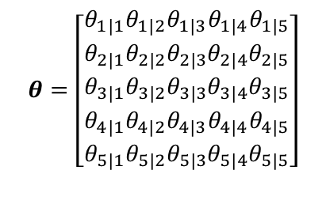


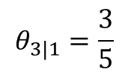


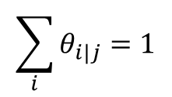


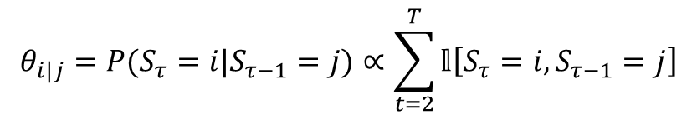
Fitting Markov Models
$${ S_{1}}_{ }$$
$${S_{2}}_{ }$$
$$S_{3}$$
$$⋯$$
$${ S_{t}}_{ }$$
$$⋯$$
$${ S_{T}}_{ }$$
Given a sequence $({S_{1}=s}_{1}, {S_{2}=s}_{2},…, {{ S_{T}}_{ }=s}_{T})$, how to construct the transition matrix?
$$θ_{i|j}=P(S_{τ}=i|S_{τ−1}=j)∝\sum_{t=2}^{T}{𝕝\left[S_{τ}=i,S_{τ−1}=j\right]}$$
$$θ=\left[\begin{aligned}θ_{1|1} \\ θ_{2|1} \\ θ_{3|1} \\ θ_{4|1} \\ θ_{5|1}\end{aligned}\begin{aligned}θ_{1|2} \\ θ_{2|2} \\ θ_{3|2} \\ θ_{4|2} \\ θ_{5|2}\end{aligned}\begin{aligned}θ_{1|3} \\ θ_{2|3} \\ θ_{3|3} \\ θ_{4|3} \\ θ_{5|3}\end{aligned}\begin{aligned}θ_{1|4} \\ θ_{2|4} \\ θ_{3|4} \\ θ_{4|4} \\ θ_{5|4}\end{aligned}\begin{aligned}θ_{1|5} \\ θ_{2|5} \\ θ_{3|5} \\ θ_{4|5} \\ θ_{5|5}\end{aligned}\right]$$
State transition matrix
$$\sum_{i}^{ }{θ_{i|j}=1}$$
$$θ_{3|1}=\frac{3}{5}$$
If we have $s_{1:t}=1, 3, 2, 4, 1, 4, 3, 5, 1, 3, 4, 2, 1, 4, 4, 2, 4, 5, 1, 3, 3, 4,…$

Slide 8




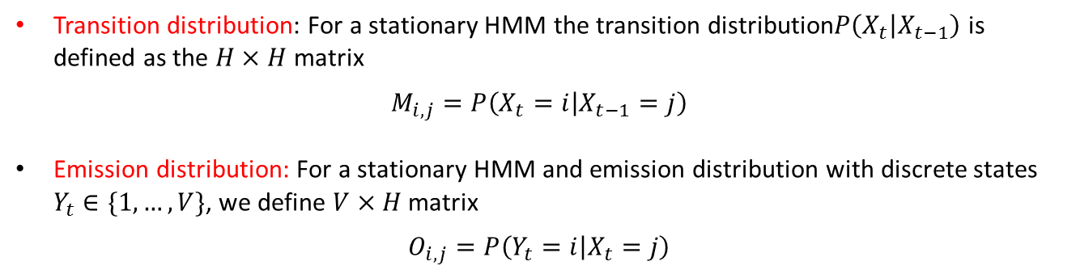
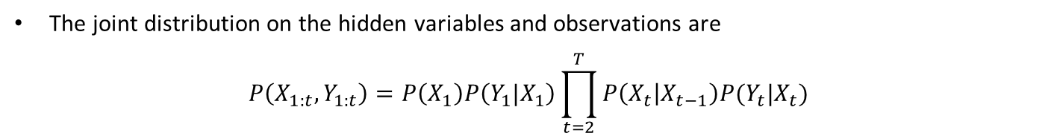








Definition of Hidden Markov Models
The Hidden Markov Model (HMM) defines a Markov chain on hidden variables $X_{1:t}$
The observed variables are dependent on the hidden variables through an emission$P(Y_{t}|X_{t})$
$$X_{1}$$
$${{ X}_{2}}_{ }$$
$${X_{3}}_{ }$$
$$⋯$$
$${{ X}_{t}}_{ }$$
$$⋯$$
$${{ X}_{T}}_{ }$$
$${ Y_{1}}_{ }$$
$${{ Y}_{2}}_{ }$$
$${{ Y}_{3}}_{ }$$
$$⋯$$
$${{ Y}_{t}}_{ }$$
$$⋯$$
$${Y_{T}}_{ }$$
The joint distribution on the hidden variables and observations are
$$P\left(X_{1:t},Y_{1:t}\right)=P\left(X_{1}\right)P\left(Y_{1}|X_{1}\right)\prod_{t=2}^{T}{P\left(X_{t} | X_{t−1}\right)P(Y_{t}|X_{t})}$$
Transition distribution: For a stationary HMM the transition distribution$P\left(X_{t} | X_{t−1}\right)$ is defined as the $H×H$ matrix
$$M_{i,j}=P\left(X_{t}=i | X_{t−1}=j\right)$$
Emission distribution: For a stationary HMM and emission distribution with discrete states $Y_{t}∈\{1,…,V\}$, we define $V$ $×H$ matrix
$$O_{i,j}=P\left(Y_{t}=i | X_{t}=j\right)$$

Slide 9





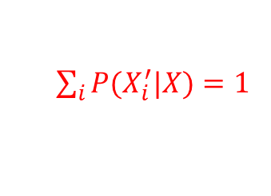

Hidden Markov Model
The state variable${ X}_{t}$ is discrete
The state transition model $P(X^{′}|X)$ is usually sparse,
→can be represented as a directed graph
${X=(X_{1}, X_{2}, X_{3}, X_{4}}_{ }^{ })$ : 4 discretized states
0.5
0.3
0.1
$${ X_{1 }^{ }}_{ }$$
0.7
$${ X_{2 }^{ }}_{ }$$
0.4
$${ X_{3 }^{ }}_{ }$$
0.5
$${ X_{4 }^{ }}_{ }$$
$\sum_{i}^{ }{P(X_{i}^{′}|X})=1$
0.6
0.9
The observation model : $P(Y^{ }|X)$ can be deterministic or random

Slide 10













Inferencing of Hidden Markov Models
Filtering (inferencing the present)$P(x_{t}|y_{1:t})$
Prediction (inferencing the future) $P\left(x_{t} | y_{1:s}\right) t>s$
Smoothing (inferencing the past)$P\left(x_{t} | y_{1:u}\right) t<u$
Likelihood (inferencing the past)$P(x_{1:t})$
$$arg\max_{x_{1:t}}{P(x_{1:t}|y_{1:t})}$$
Most likely hidden path (Viterbi alignment)
Target variable
$$X_{1}$$
$${{ X}_{2}}_{ }$$
$${X_{3}}_{ }$$
$$⋯$$
$${{ X}_{t}}_{ }$$
$$⋯$$
$${{ X}_{T}}_{ }$$
$${ Y_{1}}_{ }$$
$${{ Y}_{2}}_{ }$$
$${{ Y}_{3}}_{ }$$
$$⋯$$
$${{ Y}_{t}}_{ }$$
$$⋯$$
$${Y_{T}}_{ }$$
Observations

Slide 11





Inferencing of Hidden Markov Models
Filtering (inferencing the present)$P(x_{t}|y_{1:t})$
Prediction (inferencing the future) $P\left(x_{t} | y_{1:s}\right) t>s$
Smoothing (inferencing the past)$P\left(x_{t} | y_{1:u}\right) t<u$
Likelihood (inferencing the past)$P(x_{1:t})$
$$arg\max_{x_{1:t}}{P(x_{1:t}|y_{1:t})}$$
Most likely hidden path (Viterbi alignment)
Target variable
$$X_{1}$$
$${{ X}_{2}}_{ }$$
$${X_{s}}_{ }$$
$$⋯$$
$${{ X}_{t}}_{ }$$
$$⋯$$
$${{ X}_{u}}_{ }$$
$${ Y_{1}}_{ }$$
$${{ Y}_{2}}_{ }$$
$${{ Y}_{s}}_{ }$$
$$⋯$$
$${{ Y}_{t}}_{ }$$
$$⋯$$
$${Y_{u}}_{ }$$
Observations

Slide 12

Inferencing of Hidden Markov Models
Filtering (inferencing the present)$P(x_{t}|y_{1:t})$
Prediction (inferencing the future) $P\left(x_{t} | y_{1:s}\right) t>s$
Smoothing (inferencing the past)$P\left(x_{t} | y_{1:u}\right) t<u$
Likelihood (inferencing the past)$P(x_{1:t})$
$$arg\max_{x_{1:t}}{P(x_{1:t}|y_{1:t})}$$
Most likely hidden path (Viterbi alignment)
Target variable
$$X_{1}$$
$${{ X}_{2}}_{ }$$
$${X_{s}}_{ }$$
$$⋯$$
$${{ X}_{t}}_{ }$$
$$⋯$$
$${{ X}_{u}}_{ }$$
$${ Y_{1}}_{ }$$
$${{ Y}_{2}}_{ }$$
$${{ Y}_{s}}_{ }$$
$$⋯$$
$${{ Y}_{t}}_{ }$$
$$⋯$$
$${Y_{u}}_{ }$$
Observations

Slide 13










Inferencing of Hidden Markov Models
Filtering (inferencing the present)$P(x_{t}|y_{1:t})$
Prediction (inferencing the future) $P\left(x_{t} | y_{1:s}\right) t>s$
Smoothing (inferencing the past)$P\left(x_{t} | y_{1:u}\right) t<u$
Likelihood (inferencing the past)$P(x_{1:t})$
$$arg\max_{x_{1:t}}{P(x_{1:t}|y_{1:t})}$$
Most likely hidden path (Viterbi alignment)
Target variable
$$X_{1}$$
$${{ X}_{2}}_{ }$$
$${X_{s}}_{ }$$
$$⋯$$
$${{ X}_{t}}_{ }$$
$$⋯$$
$${{ X}_{u}}_{ }$$
$${ Y_{1}}_{ }$$
$${{ Y}_{2}}_{ }$$
$${{ Y}_{s}}_{ }$$
$$⋯$$
$${{ Y}_{t}}_{ }$$
$$⋯$$
$${Y_{u}}_{ }$$
Observations

Slide 14
Inferencing of Hidden Markov Models
Filtering (inferencing the present)$P(x_{t}|y_{1:t})$
Prediction (inferencing the future) $P\left(x_{t} | y_{1:s}\right) t>s$
Smoothing (inferencing the past)$P\left(x_{t} | y_{1:u}\right) t<u$
Likelihood (inferencing the past)$P(x_{1:t})$
$$arg\max_{x_{1:t}}{P(x_{1:t}|y_{1:t})}$$
Most likely hidden path (Viterbi alignment)
Target variable
$$X_{1}$$
$${{ X}_{2}}_{ }$$
$${X_{s}}_{ }$$
$$⋯$$
$${{ X}_{t}}_{ }$$
$$⋯$$
$${{ X}_{u}}_{ }$$
$${ Y_{1}}_{ }$$
$${{ Y}_{2}}_{ }$$
$${{ Y}_{s}}_{ }$$
$$⋯$$
$${{ Y}_{t}}_{ }$$
$$⋯$$
$${Y_{u}}_{ }$$
Observations

Slide 15
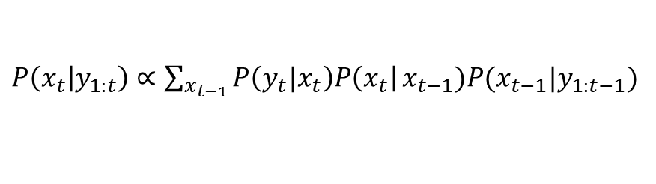

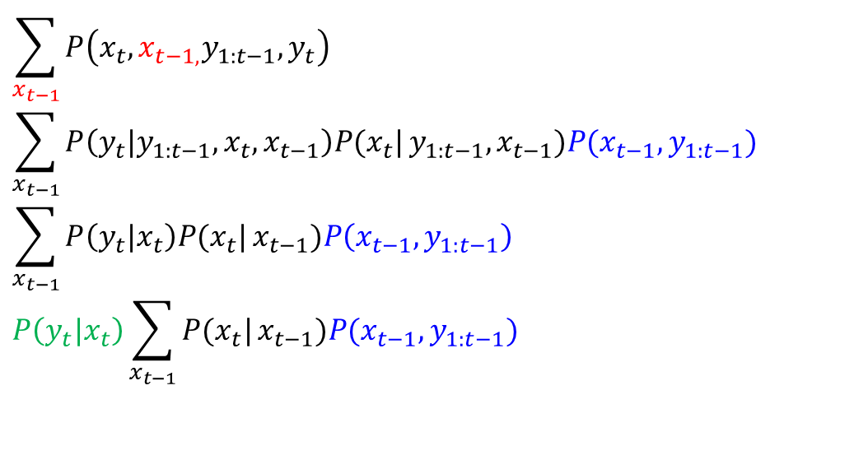

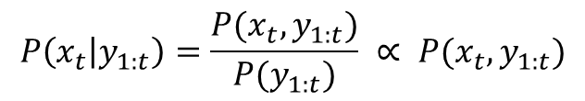
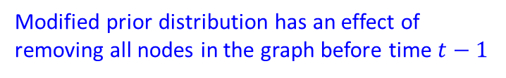
Inferencing of Hidden Markov Models
Filtering (inferencing the present) $P(x_{t}|y_{1:t})$
$$P\left(x_{t} | y_{1:t}\right)=\frac{P(x_{t},y_{1:t})}{P(y_{1:t})} ∝ P(x_{t},y_{1:t})$$
$$\sum_{x_{t−1}}^{ }{P\left(x_{t},x_{t−1,}y_{1:t−1}, y_{t}\right)}$$
$$\sum_{x_{t−1}}^{ }{P\left(y_{t}|y_{1:t−1},x_{t}, x_{t−1}\right)P(x_{t}|}y_{1:t−1},x_{t−1})P({x_{t−1},y}_{1:t−1})$$
$$\sum_{x_{t−1}}^{ }{P\left(y_{t}|x_{t}\right)P(x_{t}|}x_{t−1})P\left({x_{t−1},y}_{1:t−1}\right)$$
$$P\left(y_{t}|x_{t}\right)\sum_{x_{t−1}}^{ }{P(x_{t}|}x_{t−1})P({x_{t−1},y}_{1:t−1})$$
$$P\left(x_{t},y_{1:t}\right)=$$
$∵$Conditional independence
corrector
predictor
Bayesian view
$P\left(x_{t} | y_{1:t}\right)$ $∝\sum_{x_{t−1}}^{ }{P\left(y_{t}|x_{t}\right)P\left(x_{t}\right|}x_{t−1})P({x_{t−1}|y}_{1:t−1})$
Regarded as likelihood
Modified prior distribution has an effect of removing all nodes in the graph before time $t−1$

Slide 16





















Input and output hidden Markov Model (IOHMM)
$${ A_{1}}_{ }$$
$${ A_{2}}_{ }$$
$${ A_{3}}_{ }$$
$$⋯$$
$${ A_{t}}_{ }$$
$$⋯$$
$$A_{T}$$
$$X_{1}$$
$$X_{2}$$
$${ X_{3}}_{ }$$
$$⋯$$
$${ X_{t}}_{ }$$
$$⋯$$
$${ X_{T}}_{ }$$
$${ Y_{1}}_{ }$$
$${ Y_{2}}_{ }$$
$$Y_{3}$$
$$⋯$$
$${ Y_{t}}_{ }$$
$$⋯$$
$${ Y_{T}}_{ }$$
The state transition model : $P(X_{t}|X_{t−1}, A_{t})$
The observation model : $P(Y_{t}^{ }|X_{t},A_{t})$

Slide 17
Continuous domain

Slide 18
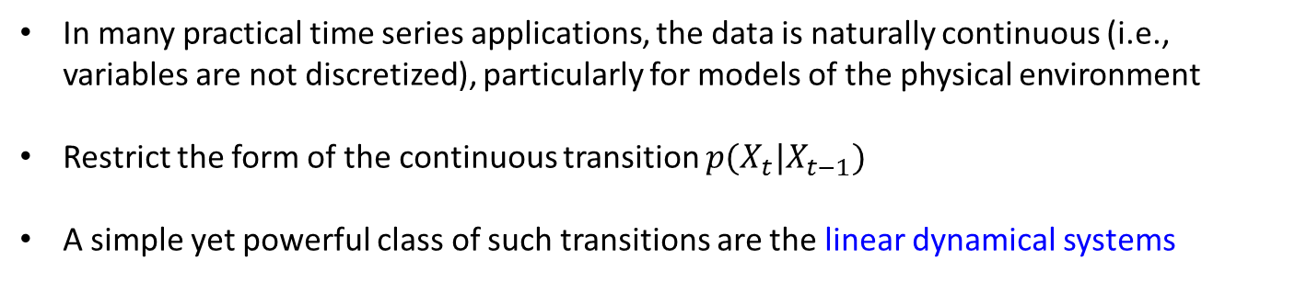
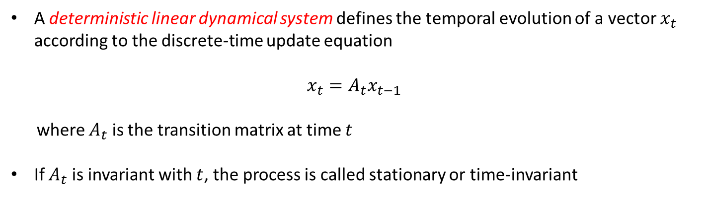
Continuous-state Markov models
In many practical time series applications, the data is naturally continuous (i.e., variables are not discretized), particularly for models of the physical environment
Restrict the form of the continuous transition $p(X_{t}|X_{t−1})$
A simple yet powerful class of such transitions are the linear dynamical systems
A deterministic linear dynamical system defines the temporal evolution of a vector $x_{t}$ according to the discrete-time update equation
$$x_{t}=A_{t}x_{t−1}$$
where $A_{t}$ is the transition matrix at time $t$
If $A_{t}$ is invariant with $t$, the process is called stationary or time-invariant

Slide 19
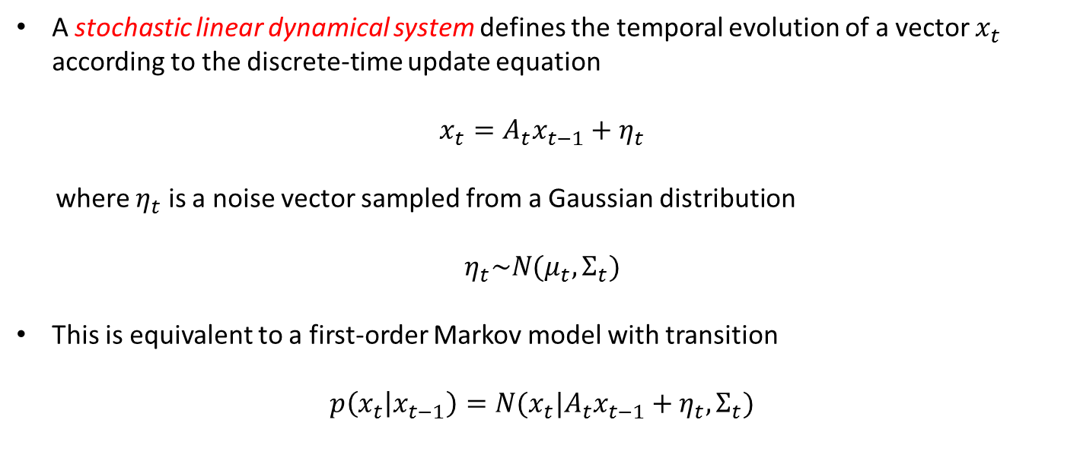
Observed linear dynamic system
A stochastic linear dynamical system defines the temporal evolution of a vector $x_{t}$ according to the discrete-time update equation
$$x_{t}=A_{t}x_{t−1}+η_{t}$$
where $η_{t}$ is a noise vector sampled from a Gaussian distribution
$$η_{t}\sim N(μ_{t}, Σ_{t})$$
This is equivalent to a first-order Markov model with transition
$$p\left(x_{t} | x_{t−1}\right)=N(x_{t}|A_{t}x_{t−1}+η_{t},Σ_{t})$$

Slide 20

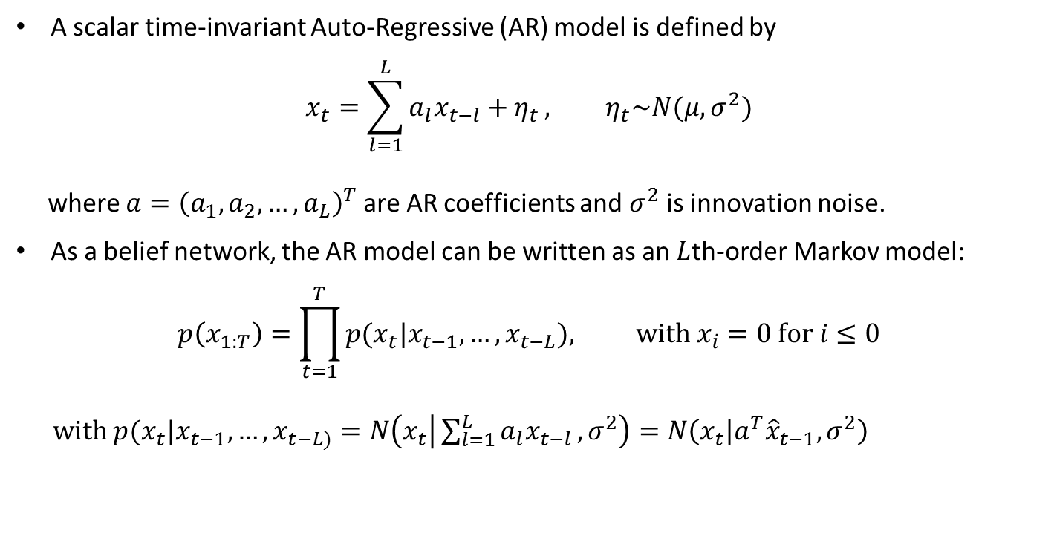




Auto-regressive models
$$x_{1}$$
$$x_{2}$$
$$x_{3}$$
$$x_{4}$$
A scalar time-invariant Auto-Regressive (AR) model is defined by
$$x_{t}=\sum_{l=1}^{L}{a_{l}x_{t−l}+η_{t}}, η_{t}\sim N(μ, σ^{2})$$
where $a={\left(a_{1}, a_{2}, …,a_{L}\right)}^{T}$ are AR coefficients and $σ^{2}$ is innovation noise.
As a belief network, the AR model can be written as an $L$th-order Markov model:
$$p\left(x_{1:T}\right)=\prod_{t=1}^{T}{p(x_{t}|x_{t−1},…,x_{t−L}), with x_{i}=0 for i≤0}$$
with $p(x_{t}|x_{t−1},…,x_{t−L)}=N\left(x_{t} | \sum_{l=1}^{L}{a_{l}x_{t−l}},σ^{2}\right)=N\left(x_{t} | a^{T}{\hat{x}}_{t−1},σ^{2}\right)$
$${\hat{x}}_{t−1}=\left(x_{t−1},…,x_{t−L}\right)$$
Similar to Bayesian Regression
Heavily used in financial time series prediction, being able to capture simple trends in the data
The AR coefficients form a compressed representation of the signal

Slide 21
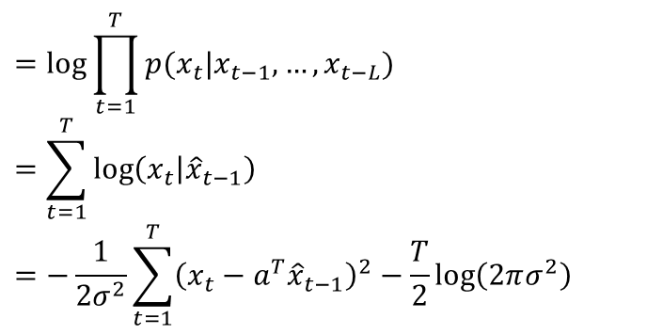

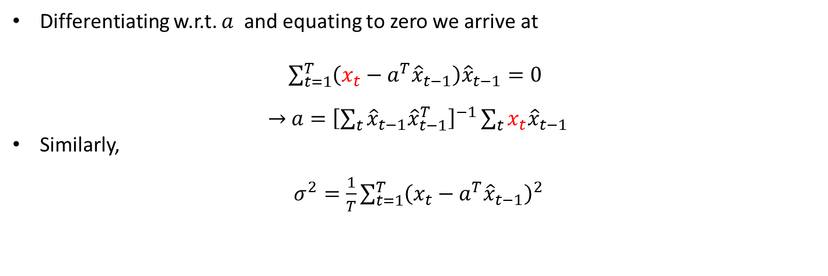

Training Auto-regressive model
Maximum likelihood training of the AR coefficients is straightforward based on
$$=\log{\prod_{t=1}^{T}{p(x_{t}|x_{t−1},…,x_{t−L})}}$$
$$=\sum_{t=1}^{T}{\log\left(x_{t} | {\hat{x}}_{t−1}\right)}$$
$$=−\frac{1}{2σ^{2}}\sum_{t=1}^{T}{{\left(x_{t}−a^{T}{\hat{x}}_{t−1}\right)}^{2}−\frac{T}{2}\log\left(2πσ^{2}\right)}$$
$$\log{p\left(x_{1:T}\right)}$$
Differentiating w.r.t. $a$ and equating to zero we arrive at
$\sum_{t=1}^{T}{\left(x_{t}−a^{T}{\hat{x}}_{t−1}\right){\hat{x}}_{t−1}=0}$
$→$ $a={\left[\sum_{t}^{ }{{\hat{x}}_{t−1}{\hat{x}}_{t−1}^{T}}\right]}^{−1}\sum_{t}^{ }{{x_{t}\hat{x}}_{t−1}}$
Similarly,
$σ^{2}=\frac{1}{T}\sum_{t=1}^{T}{{\left(x_{t}−a^{T}{\hat{x}}_{t−1}\right)}^{2}}$
$x_{t}$ : target output (scalar)

Slide 22

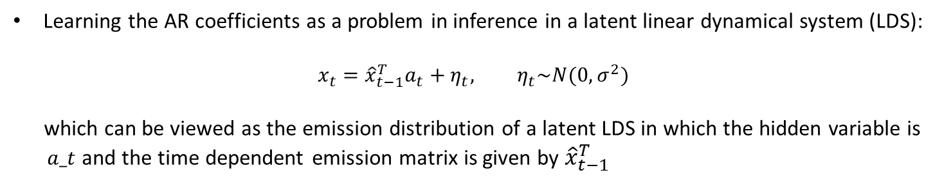






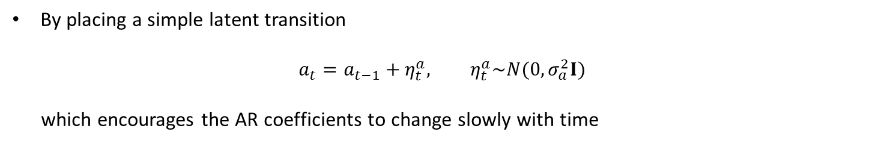

Time-varying Auto-regressive model
Learning the AR coefficients as a problem in inference in a latent linear dynamical system (LDS):
$$x_{t}={\hat{x}}_{t−1}^{T}a_{t}+η_{t}, η_{t}\sim N(0, σ^{2})$$
which can be viewed as the emission distribution of a latent LDS in which the hidden variable is
$a_t$ and the time dependent emission matrix is given by ${\hat{x}}_{t−1}^{T}$
By placing a simple latent transition
$$a_{t}=a_{t−1}+η_{t}^{a}, η_{t}^{a}\sim N(0, σ_{a}^{2}I)$$
which encourages the AR coefficients to change slowly with time
$$a_{1}$$
$$a_{2}$$
$$a_{3}$$
$$a_{4}$$
$$x_{1}$$
$$x_{2}$$
$$x_{3}$$
$$x_{4}$$

Slide 23
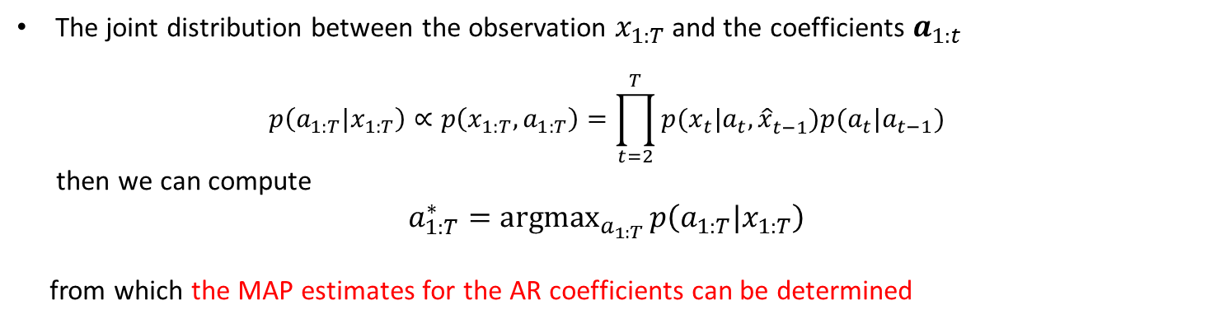
Time-varying Auto-regressive model
Learning the AR coefficients as a problem in inference in a latent linear dynamical system (LDS):
$$x_{t}={\hat{x}}_{t−1}^{T}a_{t}+η_{t}, η_{t}\sim N(0, σ^{2})$$
which can be viewed as the emission distribution of a latent LDS in which the hidden variable is
$a_t$ and the time dependent emission matrix is given by ${\hat{x}}_{t−1}^{T}$
By placing a simple latent transition
$$a_{t}=a_{t−1}+η_{t}^{a}, η_{t}^{a}\sim N(0, σ_{a}^{2}I)$$
which encourages the AR coefficients to change slowly with time
The joint distribution between the observation $x_{1:T}$ and the coefficients $a_{1:t}$
$$p\left(a_{1:T}|x_{1:T}\right)∝p\left(x_{1:T}, a_{1:T}\right)=\prod_{t=2}^{T}{p(x_{t}|a_{t},{\hat{x}}_{t−1}^{ }})p(a_{t}|a_{t−1})$$
then we can compute
$a_{1:T}^{∗}=\underset{a_{1:T}}{argmax}{p\left(a_{1:T}|x_{1:T}\right)}$
from which the MAP estimates for the AR coefficients can be determined

Slide 24

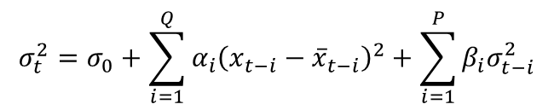
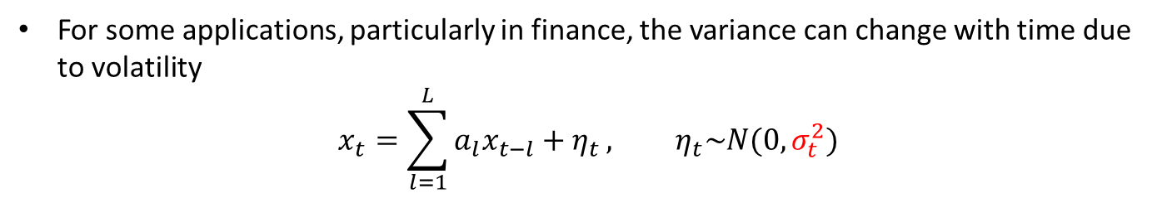

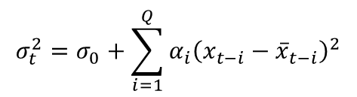
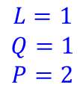







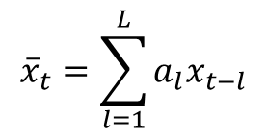
Time-varying variance Auto-regressive model
For some applications, particularly in finance, the variance can change with time due to volatility
$$x_{t}=\sum_{l=1}^{L}{a_{l}x_{t−l}+η_{t}}, η_{t}\sim N(0, σ_{t}^{2})$$
Time varying variance
$${\overline{x}}_{t}=\sum_{l=1}^{L}{a_{l}x_{t−l}}$$
The estimated time varying variance of noise can be computed
Auto Regressive Conditional Heteroscedasticity (ARCH)
Generalized ARCH model (GARCH)
$$σ_{1}^{2}$$
$$σ_{2}^{2}$$
$$σ_{3}^{2}$$
$$σ_{1}^{2}$$
$$σ_{2}^{2}$$
$$σ_{3}^{2}$$
$$L=1$$
$$Q=1$$
$$L=1$$
$$Q=1$$
$$P=2$$
$$x_{1}$$
$$x_{2}$$
$$x_{3}$$
$$x_{1}$$
$$x_{2}$$
$$x_{3}$$
$$σ_{t}^{2}=σ_{0}+\sum_{i=1}^{Q}{α_{i}{\left(x_{t−i}−{\overline{x}}_{t−i}\right)}^{2}}$$
$$σ_{t}^{2}=σ_{0}+\sum_{i=1}^{Q}{α_{i}{\left(x_{t−i}−{\overline{x}}_{t−i}\right)}^{2}}+\sum_{i=1}^{P}{β_{i}σ_{t−i}^{2}}$$

Slide 25


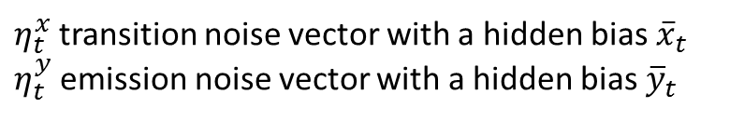
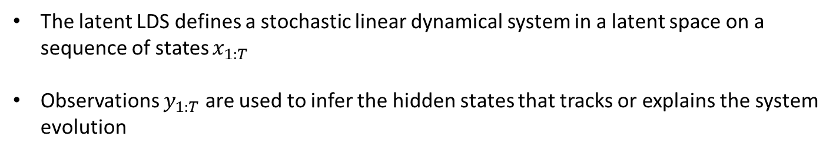


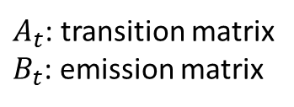








Linear Gaussian State Space Model
The latent LDS defines a stochastic linear dynamical system in a latent space on a sequence of states $x_{1:T}$
Observations $y_{1:T}$ are used to infer the hidden states that tracks or explains the system evolution
$$X_{1}$$
$${{ X}_{2}}_{ }$$
$${X_{3}}_{ }$$
$$⋯$$
$${{ X}_{t}}_{ }$$
$$⋯$$
$${{ X}_{T}}_{ }$$
$${ Y_{1}}_{ }$$
$${{ Y}_{2}}_{ }$$
$${{ Y}_{3}}_{ }$$
$$⋯$$
$${{ Y}_{t}}_{ }$$
$$⋯$$
$${Y_{T}}_{ }$$
Transition model : $x_{t}=A_{t}x_{t−1}+η_{t}^{x}, η_{t}^{x}\sim N({\overline{x}}_{t}, Σ_{t}^{x})$
Emission model : $y_{t}=B_{t}x_{t}+η_{t}^{y}, η_{t}^{y}\sim N({\overline{y}}_{t}, Σ_{t}^{y})$
$A_{t}$: transition matrix
$B_{t}$: emission matrix
$η_{t}^{x}$ transition noise vector with a hidden bias ${\overline{x}}_{t}$
$η_{t}^{y}$ emission noise vector with a hidden bias ${\overline{y}}_{t}$

Slide 26
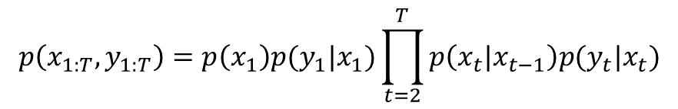
Linear Gaussian State Space Model
The latent LDS defines a stochastic linear dynamical system in a latent space on a sequence of states $x_{1:T}$
Observations $y_{1:T}$ are used to infer the hidden states that tracks or explains the system evolution
$$X_{1}$$
$${{ X}_{2}}_{ }$$
$${X_{3}}_{ }$$
$$⋯$$
$${{ X}_{t}}_{ }$$
$$⋯$$
$${{ X}_{T}}_{ }$$
$${ Y_{1}}_{ }$$
$${{ Y}_{2}}_{ }$$
$${{ Y}_{3}}_{ }$$
$$⋯$$
$${{ Y}_{t}}_{ }$$
$$⋯$$
$${Y_{T}}_{ }$$
Transition model : $p\left(x_{t} | x_{t−1}\right)=N\left(x_{t} | A_{t}x_{t−1}+{\overline{x}}_{t}, Σ_{t}^{x}\right), p\left(x_{1}\right)=N\left(x_{1} | μ_{π}, Σ_{π}\right)$
Emission model : $p\left(y_{t} | x_{t}\right)=N\left(y_{t} | B_{t}x_{t}+{\overline{y}}_{t}, Σ_{t}^{y}\right)$
The first order Markov model is then defined as
$$p\left(x_{1:T},y_{1:T}\right)=p\left(x_{1}\right)p(y_{1}|x_{1})\prod_{t=2}^{T}{p\left(x_{t}|x_{t−1}\right)p(y_{t}|x_{t})}$$

Slide 27

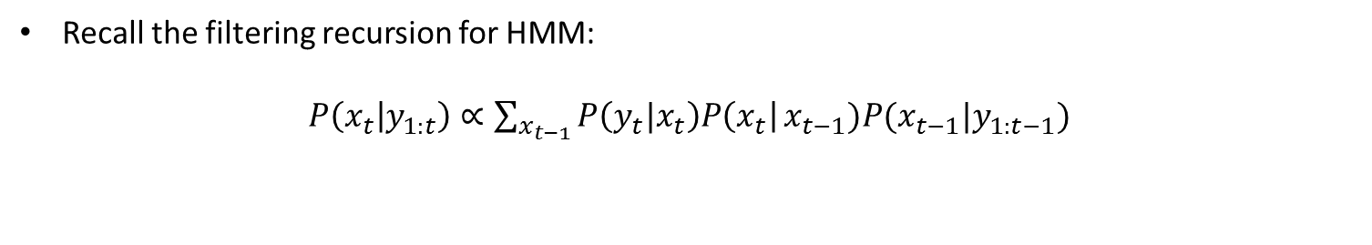



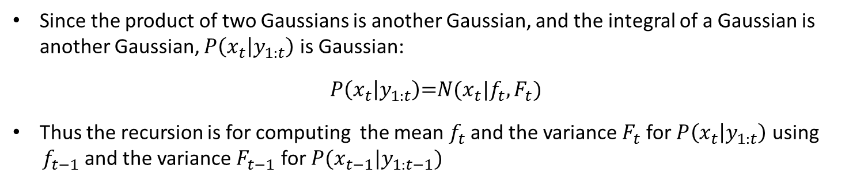

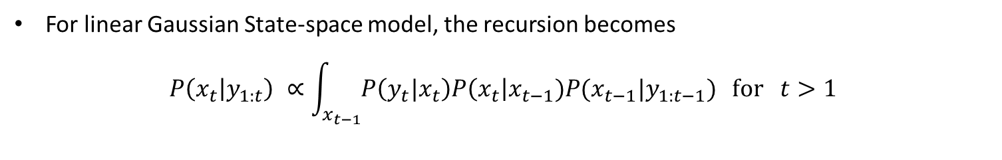

Kalman Filter
Recall the filtering recursion for HMM:
$P\left(x_{t} | y_{1:t}\right)$ $∝\sum_{x_{t−1}}^{ }{P\left(y_{t}|x_{t}\right)P\left(x_{t}\right|}x_{t−1})P({x_{t−1}|y}_{1:t−1})$
For linear Gaussian State-space model, the recursion becomes
$$P\left(x_{t} | y_{1:t}\right) ∝\int_{x_{t−1}}^{ }{P\left(y_{t}|x_{t}\right)P\left(x_{t}\right|x_{t−1})P({x_{t−1}|y}_{1:t−1})} for t>1$$
Since the product of two Gaussians is another Gaussian, and the integral of a Gaussian is another Gaussian, $P\left(x_{t} | y_{1:t}\right)$ is Gaussian:
$$P\left(x_{t} | y_{1:t}\right)\text{=}N(x_{t}|f_{t}, F_{t})$$
Thus the recursion is for computing the mean $f_{t}$ and the variance $F_{t}$ for $P\left(x_{t} | y_{1:t}\right)$ using
$f_{t−1}$ and the variance $F_{t−1}$ for $P({x_{t−1}|y}_{1:t−1})$
$$f_{t−1}$$
$$f_{t}$$
Update
$$F_{t−1}$$
$$F_{t}$$
$$P\left(x_{t−1} | y_{1:t−1}\right)=N(x_{t−1}|f_{t−1}, F_{t−1})$$
$$P\left(x_{t} | y_{1:t}\right)=N(x_{t}|f_{t}, F_{t})$$

Slide 28
Kalman Filter

Slide 29
Supplements

